Slide 1
Website Security
What you need to Know

Slide 2
Who am I?
Mitchel Sellers
Microsoft MVP, ASPInsider, DNN MVP
CEO @ IowaComputerGurus, Inc.
Contact Information
msellers@iowacomputergurus.com
https://www.mitchelsellers.com
Twitter: @mitchelsellers

Slide 3
Agenda
Who, What, Why? Adopting a Security Culture
SSL & Quick Fixes
Overview of OWASP Top 10
ASP.NET Specific Examples
Resources
Notes:
Lots to talk about, very short time

Slide 4
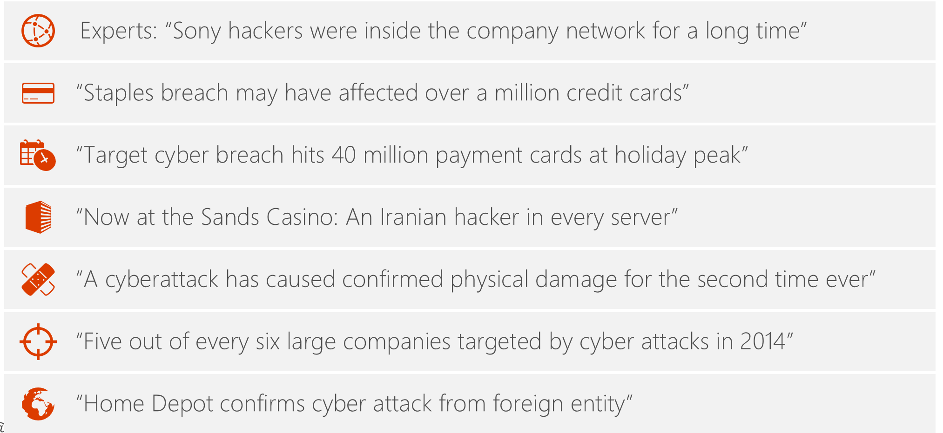
Don’t Get Caught With Your Guard Down
Notes:
Examples that have happened in the past few years, could easily have updated to include more

Slide 5
Complete Principles of Security
Security – Not just a set of protocols, but a mindset
Privacy – True privacy, and trust
Compliance – Compliance by design, not because of “incident”
Transparency – If something happens, be transparent
Notes:
The key is to treat security as a feature, not just “that thing you have to do”

Slide 6
Legal Considerations?
HIPPA – Medical Information
Need to Know
Environment Hardening Requirements
Audit/Access Logging
PCI-DSS – Credit Card/Payment Information
Encryption
Limitation of Storage
GDPR – EU Data Protection
Extract Requirements
“Disappear” Requirements
Explicit Consent
Notes:
Here are the rules…..
…Now lets start with the basics

Slide 7
To SSL or Not SSL: It Isn’t a Question
SSL is now the “default” not an optional item
SEO performance is impacted
Regardless of login, privacy or otherwise
Notes:
Google Changes in 2017, FireFox changes in early 2018, Chrome changes in late 2018

Slide 8
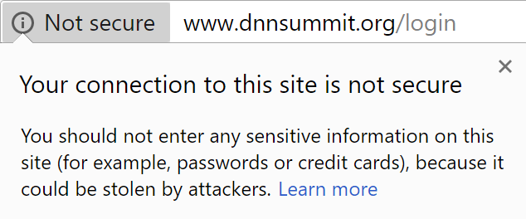
But Really, Do I?
Messaging
Trust
Notes:
Right away this causes fear

Slide 9
Installation Alone Isn’t Enough
Hard external URL links may no longer work properly, harming site traffic and SEO.
Site visitors might see “mixed content” – both secure and unsecure.
Users attempting to access sites from more secure and corporate networks may be unable to do so because of firewall security rules.
SEO asset value within search engine indexing may be damaged or lost.
If your home page indicates SSL security, but not all pages or page elements are secured, the mismatch can create corporate liability.
Notes:
What “could” go wrong
..So how can we prevent this?

Slide 10
Best Practices for SSL Implementation
Manually test pages before forcing
Force SSL for all pages after validated
IIS Rewrite
Azure Setting
Make sure that any redirects to SSL are 301 type (Validate in Browser)
Update Google Search Console
It is a new site, setup the domain, submit your sitemap etc
Notes:
IIS or Azure is more reliable, but could have unintended consequences

Slide 11
Simple Fix: HSTS
Strict Transport Security tells browsers that you EXPECT to be secure. This prevents situations where a malicious user could try to downgrade a connection to get information
Implemented as a Host Header
Strict-Transport-Security: max-age=604800; IncludeSubDomains; preload
Duration: Seconds to live (1 week as above)
IncludeSubDomains = Forces sub domains
Preload = Allows browser fetching
Warning!!! – If you set this, and you don’t have secure content your site is broken, and cache clear does not fix it!

Slide 12
Simple Fix: Content Types
Content type options tell the browser your desire for its ability to assume the type of file based on extension. By default it can try to assume, this is a security risk
Fix implemented via a header
X-Content-Type-Options: nosniff
Tells the browser that it cannot detect the type of content

Slide 13
Simple Fix: Cross Site Scripting
Other ways work to secure your site from XSS attacks, but we can also tell the browser our intentions as well, helping to secure the site further.
Implemented as a header
X-XSS-Protection: 1; mode=block

Slide 14
Simple Fix: Prevent Iframing
An iframe allows users to embed your site in theirs. Often used in man-in-the-middle style attacks
Settings exist to tell browsers “don’t do this”.
Implemented as a header
X-Frame-Options: SAMEORIGIN
Options
SAMEORIGIN = Allows current website to iframe itself
DENY = No iFrames
ALLOW-FROM = Only from a list of trusted domains

Slide 15
Simple Fix: Remove Powered By
Disclosing your technology is considered a risk as well
A x-powered-by header is added by default, this can be removed via the web.config

Slide 16
Example Config With All Simple Fixes
<httpProtocol>
<customHeaders>
<remove name="X-Powered-By" />
<add name="X-Content-Type-Options" value="nosniff" />
<add name="Access-Control-Allow-Origin" value="*" />
<add name="Access-Control-Allow-Headers" value="content-type" />
<add name="Strict-Transport-Security" value="max-age=86400; includeSubDomains" />
<remove name="X-XSS-Protection" />
<remove name="X-Frame-Options" />
<add name="X-XSS-Protection" value="1; mode=block" />
<add name="X-Frame-Options" value="SAMEORIGIN" />
</customHeaders>
</httpProtocol>

Slide 17
Taking it Further: Content Security Policy
This is the holy grail of security
Tells exactly what domains are allowed, but must be used to identify EVERYTHING
Third-party, CDN’s etc all need to be identified
Outside of the scope of today
Tutorial: https://rehansaeed.com/content-security-policy-for-asp-net-mvc/

Slide 18
Beyond Configuration: OWASP Top 10
Top 10 critical web application security issues.
Detail: https://www.owasp.org/images/7/72/OWASP_Top_10-2017_%28en%29.pdf.pdf
Testing Tools: https://www.owasp.org/index.php/Appendix_A:_Testing_Tools

Slide 19
OWASP Top 10 - #1 Injection
Most specifically talking about SQL Injection
Still an issue in 2019
Bad Example – Pulling from the id query string
“SELECT * FROM AccountHistory WHERE OwnerId = “ + id
Many ways to break this?
Random Id = Would allow users to see something they shouldn’t
Breaking Query = “ 1; DELETE FROM Users” – Drop the table
Good Example – Use parameterized queries, all cases
“SELECT * FROM AccountHistory WHERE OwnerId = @Id”
Implementation will depend on platform/language

Slide 20
Consider this

Slide 21
OWASP Top 10 - #2 Broken Authentication
Common Issues
Prevention
Permits automated login attacks
Allows default user passwords
Uses weak/insecure recovery processes (Security Question is considered “weak”)
Uses Plain-Text, Encrypted, or Weak encryption for passwords
Exposes the sessionID in URL
Consider Multi-Factor Authentication
Don’t use defaults
Check against common passwords
Ensure integrity in password requirements
Login, Lockout, Failure messages should be the same
Limit brute-force logins, and notify admins when suspected

Slide 22
OWASP Top 10 - #2 (ASP.NET Notes)
Default ASP.NET Auth covers some, but not all aspects of this
Older Methods (Membership vs. Identity)
Validate password formats
Validate & Update Password recovery
New Installations
Multi-Factor not enabled by default
Lockout Notifications (Not logged or implemented)
Complexity Requirements – Typically ok
No “known password list”

Slide 23
OWASP Top 10 - #3 Sensitive Data Exposure
Is Clear Text Transmission Used?
HTTP vs HTTPS
Non-secure Email
FTP?
Avoid storing sensitive information. (PCI-DSS Specifically)
Disable Caching for confidential data
Always use secure transmission

Slide 24
OWASP Top 10 - #4 XML External Entities
Limited to XML Data Processing
SAML & SOAP are two most common
Best Prevention is to validate XML before parsing, and disable DTD External Processing
Details: https://www.owasp.org/index.php/XML_External_Entity_(XXE)_Prevention_Cheat_Sheet

Slide 25
OWASP Top 10 - #5 Broken Access Control
Risks
Similar to risk in #1 – Situations where the URL could be modified to change access protocols
Missing authentication on child methods Assuming that if you can see ____ that by default you cannot see the rest.
CORS Misconfiguration – Allowing other clients
Prevention
Log misuse, notify if excessive
Rate Limit API’s
Invalidate tokens at logout

Slide 26
OWASP Top 10 - #6 Security Misconfiguration
Risks
Forgetting to remove defaults. (Ex sample project, Module, File)
Unnecessary features/ports (FTP, Utility Modules, etc)
Patching not followed
Prevention
Documented and repeatable hardening process (Install/Config)
Minimize platform, use custom install options
Automated validated of configuration (Trust but verify)

Slide 27
OWASP Top 10 - #7 Cross-Site Scripting
Risks
Using untrusted values and displaying
Response.Write($”<script>alert(‘{Request.Querystring[“msg”]}’);</script>”)
Can be JS or HTML
Think of Rich Text Editor
Prevention
Escape untrusted XML/HTML
Consider Content Security Policy to truly lock down data
https://www.owasp.org/index.php/XSS_(Cross_Site_Scripting)_Prevention_Cheat_Sheet

Slide 28
OWASP Top 10 - #8 Insecure Deserialization
Could happen with any serialized data that was outside of your control
Prevention is to distrust all
Examples
Cookies with list of permissions
Hidden field with userId values
Must verity, similar to that of #1, and #5

Slide 29
OWASP Top 10 - #9 Using Components With Known Vulnerabilities
Not patching a framework to deal with security issues
Not patching third-party componeents with known issues
Not patching Windows
Not patching ASP.NET
Using older FTP software
Etc.

Slide 30
OWASP Top 10 - #10 Insufficient Logging & Monitoring
Logging is great, but what do you do with it?
Monitoring/Alerting is often overlooked, until it is a problem
Activity logging should be repeatable/detailed for high-risk transactions. (Delete, etc)
Establish a response protocol

Slide 31
ASP.NET Core Specifics
Watch patching & SDK Versions
LTS & Current Support
Don’t trust that the OS Updates!

Slide 32
Third-Party Stuff
Do they follow these practices?
Just because you can’t see it, doesn’t mean it isn’t there
Could be ANY third-party library you are using
Review & Patching notifications

Slide 33
Resources
Microsoft GDPR Recommendations: https://www.microsoft.com/en-us/TrustCenter/Privacy/gdpr/readiness
OWASP Top 10 2017: https://www.owasp.org/images/7/72/OWASP_Top_10-2017_%28en%29.pdf.pdf

