Slide 1
Practical Unit Testing Patterns
With .NET Core

Slide 2
About Your Speaker
Mitchel Sellers
Microsoft MVP & ASPInsider
CEO @ IowaComputerGurus, Inc.
Contact Information
msellers@iowacomputergurus.com
Twitter: @MitchelSellers
Blog: http://www.mitchelsellers.com

Slide 3
Goals with Unit Testing
Code Coverage?
Yes, this is a metric, but could be flawed, more on this later
Better Quality Code?
How? By knowing that what the application did last week, works this week
Reduced Development Time?
By writing tests, and validating at the code level, you can proof items with less user interaction

Slide 4
Flaws with Blanket __% Of Coverage
Boiler-Plate Code
Startup.cs
Program.cs
Auto-Generated Code
EF Migrations
EF Snapshots

Slide 5
Sample Project – 2 Tests No Exclusions

Slide 6
Fixing Metrics
Writing Tests
Best choice, but not always possible
Exclude class or method
[ExcludeFromCodeCoverage] attribute
Might need to re-add this after certain actions
Creates a much more realistic picture
Lets exclude EF Migrations
Also exclude program.cs & startup.cs

Slide 7
Sample Project – With Exclusions
28% Change!

Slide 8
Unit Testing Frameworks
You have many options
Xunit
MSTest
Nunit
Which one to select?
I personally use Xunit
[Fact] & [Theory] Support makes for easier test writing
Syntax is less involved

Slide 9
Unit Testing Naming Conventions
A religious debate on its own, just focus on your standards
Method_StateUnderTest_ExpectedBehavior
IsWeekend_Monday_False
Method_ExpectedBehavior_StateUnderTest
IsWeekedn_False_Monday
Method_Condition_Result (Should/When Prefix)
IsWeekend_ShouldReturnFalse_WhenMonday

Slide 10
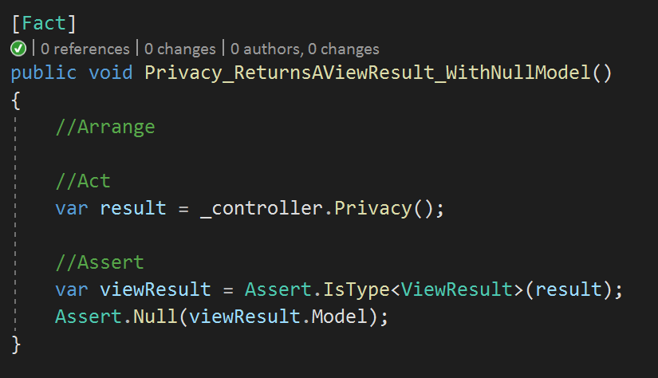
Arrangement of Tests
Arrange
Setup anything needed
Act
Perform the action
Assert
Validate the result

Slide 11
Mocking
Mock frameworks allow you to create a fake implementation of an interface
Moq NuGet package is most commonly used
Allows you to validate the call, and setup returns.

Slide 12
Untestable Code
Static Methods
Extension Methods
Similar
Fix?
Creation of “Shims” or similar.

Slide 13
Example Untestable Method

Slide 14
Fixes?

Slide 15
Home Controller Changes

Slide 16
Method Changes

Slide 17
Result

Slide 18
Resources
https://docs.microsoft.com/en-us/aspnet/core/mvc/controllers/testing?view=aspnetcore-3.0
Code: https://github.com/mitchelsellers/UnitTestingPatternsDemo

