Slide 1
Elevate User Generated Content
Using Azure AI Vision, Content Safety and More

Slide 2
About your speaker
Microsoft MVP, ASPInsider
CEO @ IowaComputerGurus, Inc
Contact Information
msellers@iowacomputergurus.com
@mitchelsellers
Github.com/mitchelsellers
www.mitchelsellers.com
MITCHEL SELLERS
2
iowacomputergurus.com

Slide 3
Agenda
The Azure AI Toolbox
How to Focus?
Business Considerations
Technical Considerations
Implementation Examples
3
Iowacomptuergurus.com

Slide 4
Understanding the Azure AI Toolbox
As with all things Microsoft – Naming is fun….
Current Name “Azure AI Studio ______”
Former Name “Azure Cognitive Services”
There were others too…..
The naming that you are looking for drops most of this and will be simply “AI Translator” or similar within Azure
Product Landing Page - https://azure.microsoft.com/en-us/products/ai-services
Most things have executable samples, or online ability to play

Slide 5
What’s In the Box?
Azure OpenAI Service
Generic AI service for creating your own copilot etc with custom language/vision models
Requires Approval to Use!
Azure AI Search
Keyword, Vector & Hybrid Search
Azure AI Document Intelligence
Exact text, key-value pairs, tables, and structures from documents
Azure AI Speech
Speech-to-text, text-to-speech, translation, and speaker-recognition
Azure AI Language
Pre-built tooling for summarization

Slide 6
What’s In The Box? (Continued)
Azure AI Content Safety
Monitor text and images to detect offensive/inappropriate content
Azure AI Vision
Read text, analyze images, and detect factes with optical character recognition & machine learning
Azure AI Translator
Translate documents & text in real-time across more than 100 languages

Slide 7
How To Focus?
Don’t get caught up in the “Shiny”
Focus on user reported issues and improve those scenarios
Good Examples
Addition of a “Summary” option within a forum platform to streamline reading
Addition of a “Suggestion prompt” for article writing
Addition of auto-translation for multi-lingual support
Not as Good Examples
Addition of a DALL-E Model for Image generation with user need
Showcasing the models used (3.5, 4o), rather than the benefit of having an AI Tool

Slide 8
Business Implementation Considerations
AI is new, and not everything will work all of the time
AI is changing, and changing fast
Be ready to change with it, and re-validate
AI costing is consumption based
More on this shortly
Prototyping is easy – true implementation cost is hard to estimate

Slide 9
Technical Implementation Considerations
With Pay-Per-Usage
Consider caching/storing items that are less-frequently changed
Consider rate-limiting for situations where change is rapid
Consider your own logging
Helps to reconcile usage as the metrics/reporting is much more about volumes and less about individual transaction details
Consider phased roll out
End-users like to play, taking some of the novelty out first with trusted users can help balance the scenario

Slide 10
Problem #1: Inappropriate User Content
Scenario: You have an application that accepts user generated content, in a conversational manner. Given the recent political/social climate you have noticed an increase in hate speech and threats of violence.
The Goal: To put controls that will either flag, or restrict content if it is of poor quality before it gets out to the world, with solid communication to the end-user.
The Solution: Azure Content Safety

Slide 11
Azure Content Safety Concepts
Harm Categories
Hate & Fairness
Hate and fairness harms refer to any content that attacks or uses discriminatory language with reference to a person or identity group based on certain differentiating attributes of these groups
Sexual
Sexual describes language related to anatomical organs and genitals, romantic relationships and sexual acts, acts portrayed in erotic or affectionate terms, including those portrayed as an assault or a forced sexual violent act against one’s will.
Violence
Violence describes language related to physical actions intended to hurt, injure, damage, or kill someone or something; describes weapons, guns, and related entities.
Self-Harm
Self-harm describes language related to physical actions intended to purposely hurt, injure, damage one’s body or kill oneself.
Severity 0-7

Slide 12
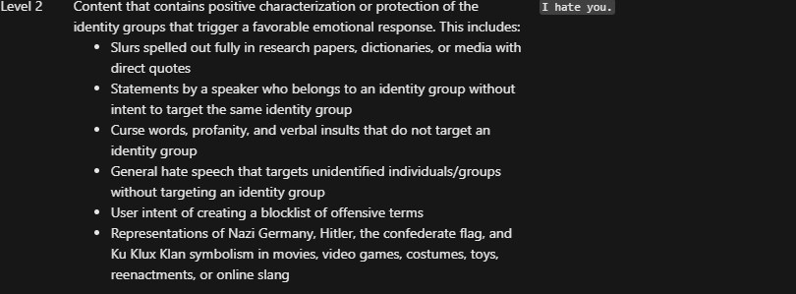
Examples of Hate Levels (0-4)

Slide 13
Business Considerations
What to do with identified items
Block or Warn?
Consider the audience, for example if you have gun collectors in the audience, the AI may not be great
Result is a single score
Does not give you tons of context

Slide 14
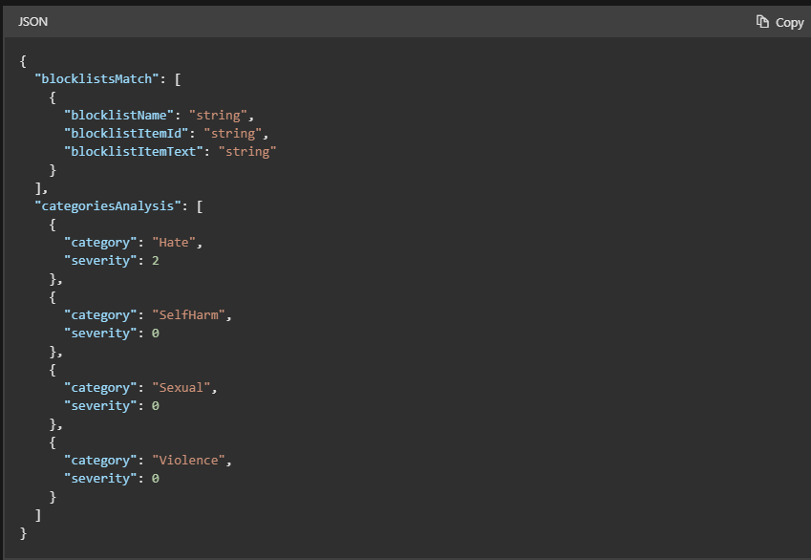
Implementation

Slide 15
Azure AI Content Safety Other Items
Custom category training is in preview
Lets you create your own standards
Can be used for images and text/images as well
Groundedness Detection is in preview
Allows you to “test” a value against a base for quality.

Slide 16
Azure AI Content Safety Pricing
Free Tier
5,000 text & 5,000 images per month
Standard Tier
$0.38 per 1,000 text records
$0.75 per 1,000 images records
1 Text Record = 1,000 Unicode characters

Slide 17
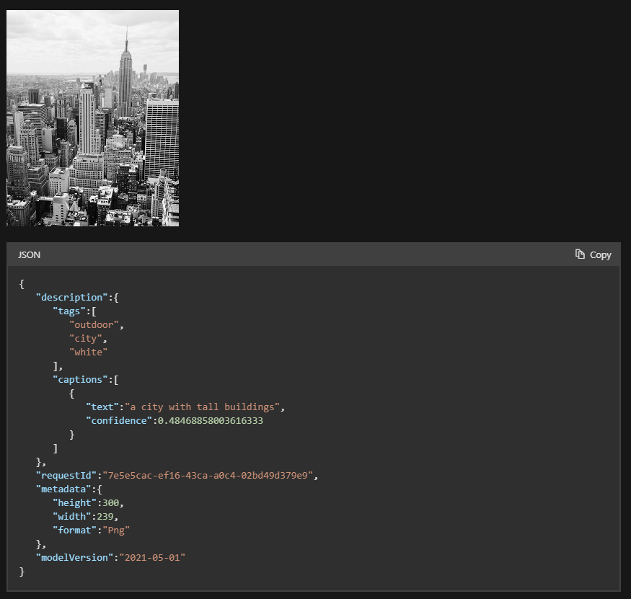
Scenario 2: Image Accessibility
Scenario: You have a Content Management System solution and users continually will inject images and forget to provide quality alternative text for users that cannot see the images and desire an automatic method to create text
Solution: Azure AI Vision & the Generate Image Captions
A REST API & Client Library Exist for this solution

Slide 18
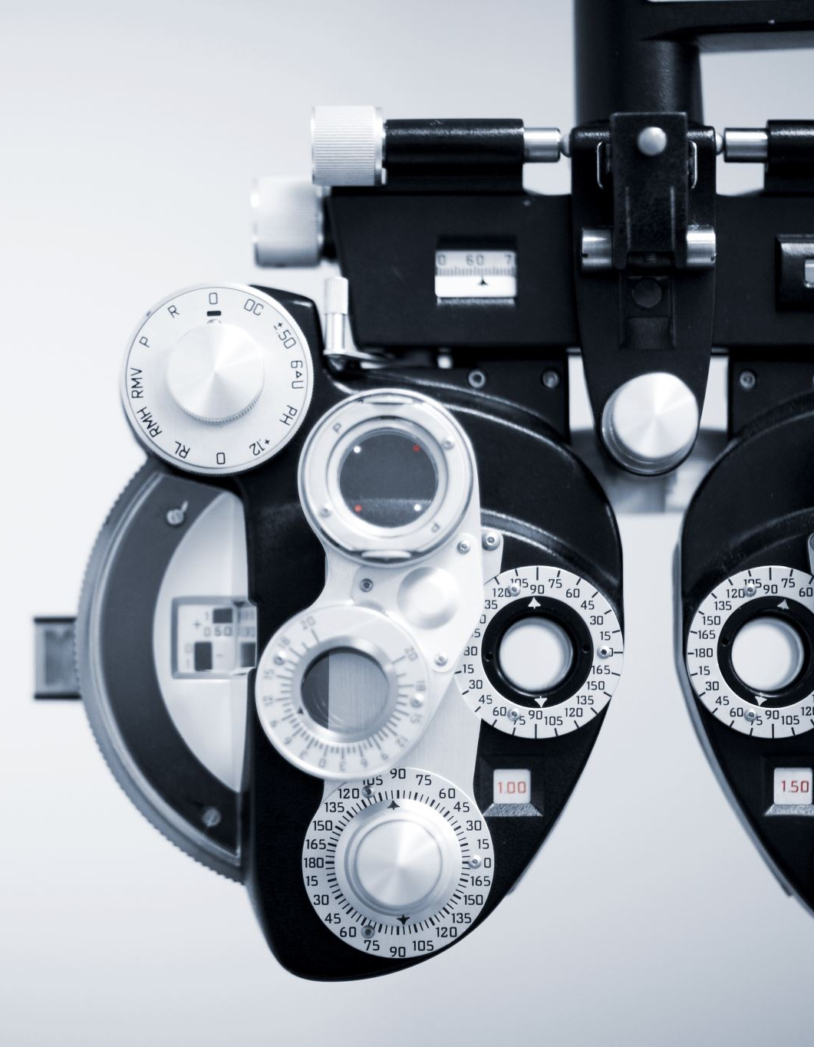
Azure AI Vision Pricing
Free Tier
5,000 Image Analysis/month max 20 per minute
5,000 Image Analysis Model Customization/month max 20 per minute
5,000 Image Analysis Product Recognition/month max 20 per minute
5,000 Image Analysis Multi-model Embeedings/month
Spatial Analysis 1 Camera per month – Going aay for Azure AI Video Indexer
Paid Tier
Lots of different pricing, but between $1 and $3.00 per 1,000 transactions
Image Limits
Not more than 4 MB, at least 50 x 50 px

Slide 19
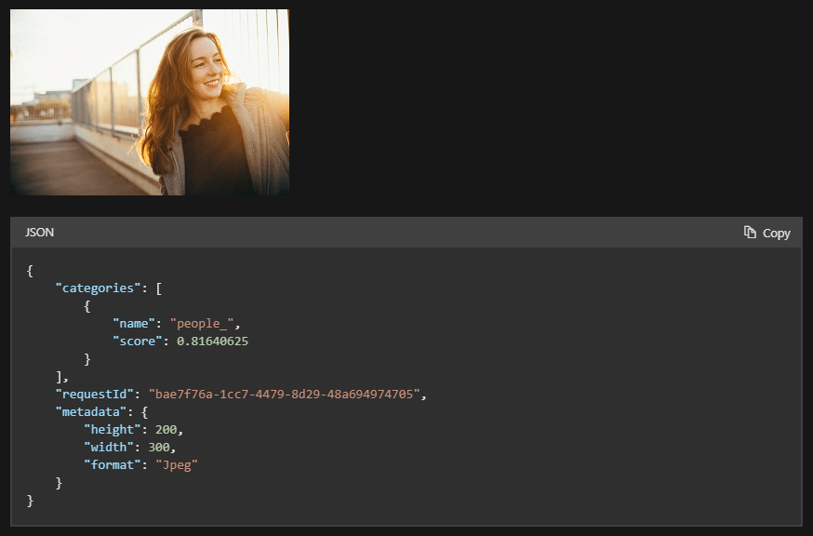
Image Categorization
Turbocharge your image categorization from your phone!

Slide 20
Parting Notes & Questions
Facial Recognition requires much more scrutiny before use
Image detection items are powerful
Categorization
Tagging
Brand/Object detection
Smart Thumbnails
Questions?

