Slide 1
Making Your ASP.NET Core Application Blazingly Fast
Understanding & Implementing Performance

Slide 2
About Your Speaker
Mitchel Sellers
CEO @ IowaComputerGurus, Inc.
10x Microsoft MVP, ASP Insider, DNN MVP
Contact Info
Blog: https://www.mitchelsellers.com
Twitter: @MitchelSellers
Email: msellers@iowacomputergurus.com

Slide 3
Agenda
Why do we care about performance?
What indicates successful performance?
Performance Myths
Understanding how webpages work
Visualizing complete page load…
.NET Core Concepts

Slide 4
Why Do We Care About Performance
Search Engine Optimization
Google Ranking
User Perception
Do I really want to work with this business?
Devices
Differing network abilities
Throttled vs Free, etc.
Traffic Peaks
Newsletters
“Going Viral”

Slide 5
What Indicates Successful Performance
Not an exact science
Can articulate a few key metrics
Anything more than 250 ms response triggers warnings from Google Page Speed Tools
User dissatisfaction starts around the 2-3 second mark
Various studies show > 25% increase in abandonment after 6 seconds

Slide 6
Common Requests
The site seems “laggy”
Three weeks ago, around noon, it was slow
Can we handle ____
Solution?
Logging/Monitoring Tools

Slide 7
Indicators of Good Sites
User experience focused, rather than true “metrics” focused
Think Expedia.com or Kayak.com
Minimal requests needed to render the website
Under load, server resource usage is linear
Metrics can be used, but can be red-herrings

Slide 8
Understanding How Webpages Work
Technical or not, understanding the order is key
Logical processing
Request/Response for main HTML
Request/Response for individual assets, after HTML processed
Request/Response for linked assets within other assets
Etc.
Limitations
Current web browsers can only request at most, 10 items per domain, at a time

Slide 9
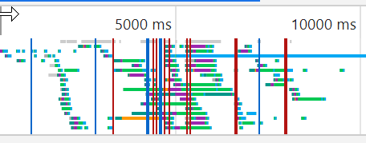
A Visualization (F12 Developer Tools)

Slide 10
Performance Myths
SSL Hurts Performance
False! Yes, there is overhead, but browsers are optimized for this
There are no quick fixes
False! Simple tasks such as response cache, static file compression, or expiration times can help
But I use a CDN, It will be fine
False! # of requests is king in performance

Slide 11
.NET Core Concepts – Bundling & Minification
Add BundlerMinifierCore NuGet Package
Add an BundleConfig.json file
[
{
"outputFileName": "wwwroot/css/combined.min.css",
"inputFiles": [
"wwwroot/lib/bootstrap/dist/css/bootstrap.css",
"wwwroot/css/site.css"
],
"minify": {
"enabled": true
}
},
{
"outputFileName": "wwwroot/js/combined.min.js",
"inputFiles": [
"wwwroot/lib/jquery/dist/jquery.js",
"wwwroot/lib/bootstrap/dist/js/bootstrap.js",
"wwwroot/lib/jquery-validation/dist/jquery.validate.js",
"wwwroot/lib/jquery-validation/dist/additional-methods.js",
"wwwroot/lib/jquery-validation-unobtrustive/jquery.validate.unobtrusive.js",
"wwwroot/js/site.js"
],
"minify": {
"enabled": true
}
}
]

Slide 12
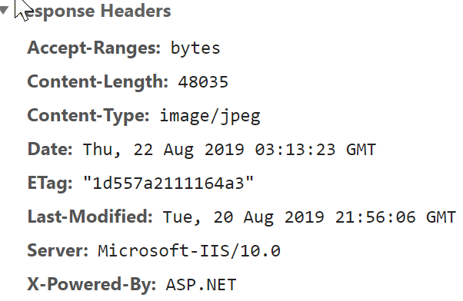
.NET Core Concepts – Static File Cache
Default Configuration
app.UseStaticFiles()
Generates an ETag and last modified header
What is the browser expected behavior?

Slide 13
.NET Core Improved Static File Caching
Add Cache Definition
app.UseStaticFiles(new StaticFileOptions
{
OnPrepareResponse = ctx =>
{
const int durationInSeconds = 60 * 60 * 24;
ctx.Context.Response.Headers[HeaderNames.CacheControl] =
"public,max-age=" + durationInSeconds;
}
});

Slide 14
.NET Core Automatic Cache Busting
asp-append-version="true“
Can be applied to
<img>
<script>
<link>
Etc.

Slide 15
.NET Core Concepts – Cache Header
Add the header to your actions/pages
[ResponseCache(VaryByHeader = "User-Agent", Duration = 30)]
Force NOT Cached
[ResponseCache(Duration = 0, Location = ResponseCacheLocation.None, NoStore = true)]
Cache Profiles
services.AddMvc(options =>
{
options.CacheProfiles.Add("Default30",
new CacheProfile()
{
Duration = 30
});
})

Slide 16
.NET Core Concepts – Cache Header Issues
DO NOT ADD TO AUTHENTICATED PAGES!
If added to ANY page with a <form> ASP.NET will skip
Error: [WRN] The 'Cache-Control' and 'Pragma' headers have been overridden and set to 'no-cache, no-store' and 'no-cache' respectively to prevent caching of this response. Any response that uses antiforgery should not be cached.

Slide 17
Taking it Further
Let ASP.NET Store it Too
app.UseResponseCaching();

Slide 18
.NET Core Concepts – Memory Caching
Caching @ Code Level
public HomepageDisplayModel GetHomepageModel()
{
//Return from cache if we can
if (_memoryCache.TryGetValue(CacheKeys.HomepageModel, out HomepageDisplayModel cachedResult))
return cachedResult;
//Otherwise get it and return
cachedResult = new HomepageDisplayModel
{
BlogPosts = _blogDataService.ListTwoMostRecentBlogPosts()
};
//Insert to cache
var options = new MemoryCacheEntryOptions{SlidingExpiration = TimeSpan.FromMinutes(15)};
_memoryCache.Set(CacheKeys.HomepageModel, cachedResult, options);
return cachedResult;
}

Slide 19
Tools & Resources for Those Looking
GTMetrix.com – Aggregates Google PageSpeed, Yslow, page waterfall view, and other metrics
Varvy.com – Combination performance & SEO tool
Best Practices : https://docs.microsoft.com/en-us/aspnet/core/performance/performance-best-practices?view=aspnetcore-2.2

